Slide 1
java: A beginners guide
Chapater G2 - Printing

Slide 2
Printing
A natural extension of Java 2D graphics is the ability to print.
Printers are considered graphics devices just like a monitor.
You can print graphics and the content of the application’s user interface.
Two main classes involved in printing:
java.awt.print
Javax.print – provides access to the printing services

Slide 3
A basic printing program
Print tasks consists of two parte:
Job control — Creating a print job, associating it with a printer, specifying the number of copies, and user print dialog interaction.
Page Imaging — Drawing content to a page, and managing content that spans pages (pagination).
Basic steps in printing:
Create a printer job
PrinterJob job = PrinterJob.GetPrinterJob();
Implement the Printable interface in the class statement
Set the print object
job.setPrintable(this);
Display the printDialog box
boolean doPrint = job.printDialog()
Call the print() method
job.print();

Slide 4
Printable Interface
Fields
static int NO_SUCH_PAGE - Returned from print to signify that the pageIndex is too large and that the requested page does not exist
static int PAGE_EXISTS - Returned from print(Graphics, PageFormat, int) to signify that the requested page was rendered.
Method
int print(Graphics graphics, PageFormat pageFormat, int pageIndex) - Prints the page at the specified index into the specified Graphics context in the specified format.
Parameters:
graphics - the context into which the page is drawn
pageFormat - the size and orientation of the page being drawn
pageIndex - the zero based index of the page to be drawn
Returns:
PAGE_EXISTS if the page is rendered successfully or NO_SUCH_PAGE if pageIndex specifies a non-existent page.
Throws:
PrinterException - thrown when the print job is terminated.

Slide 5
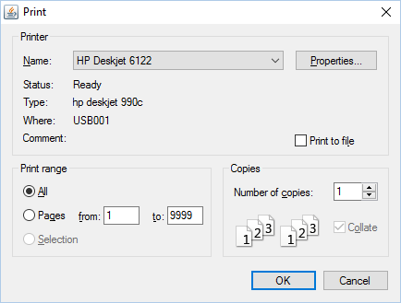
Using Print Setup Dialogs
The print dialog box is displayed by the printJob.printDialog() method
Returns true if the user clicked ok or false if the user clicked cancel.
User can select printer, print range, and number of copies.

Slide 6
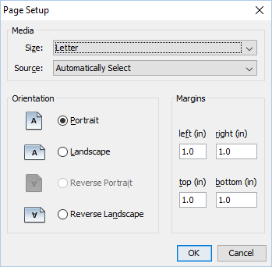
Using Print Setup Dialogs
The following code gets the system look and feel properties and displays a page dialog box.
try
{
// Use the native look and feel
String look =
UIManager.getSystemLookAndFeelClassName();
UIManager.setLookAndFeel(look);
}
catch (Exception err)
{ }
PrinterJob job = PrinterJob.getPrinterJob();
PrintRequestAttributeSet aset =
new HashPrintRequestAttributeSet();
PageFormat pf = job.pageDialog(aset);

Slide 7
Anatomy of a page
Margins
Report Title Area
Headings Area
Report Body aka detail lines
Report Footer

Slide 8
Anatomy of a page
Margins – Area surrounding the printable space
Report Title – Name of the report.
Should contain date and page number.
Headings – Data column headings
Report Body – Individual lines of data
Report Footer – Optional but may contain page totals
Overflow point – The position on the page where you force a new page to print
Since printing is a function of graphics, you have to calculate the height of the line based on the font you are using.
You must also account for any space you wish to put between lines.

Slide 9
Print a multiple page document
Most reports are more than one page.
Pagination is the process of identifying the location in a document where page breaks and printing accordingly.
Since printing is a function of graphics, you have to calculate the height of the line based on the font you are using.
To calculate the height of a single line of text, use the FontMetrics class.
Font font = new Font("Serif", Font.PLAIN, 10);
FontMetrics metrics = graphics.getFontMetrics(font);
int lineHeight = metrics.getHeight();

Slide 10
Print a multiple page document
The PageFormat parameter describes the printable area of the page. In particular, to find the vertical span of the page use the following code fragment:
double pageHeight = pageFormat.getImageableHeight();
Use the following code fragment to calculate the number of lines that fit on a page and the number of page breaks:
int linesPerPage = ((int)pageHeight)/lineHeight);
int numBreaks = (textLines.length-1)/linesPerPage;
int[] pageBreaks = new int[numBreaks];
for (int b=0; b < numBreaks; b++)
{ pageBreaks[b] = (b+1)*linesPerPage; }

Slide 11
Print a multiple page documen
The page break positions are used as represented in the following code fragment:
/* Draw each line that is on this page.
* Increment 'y' position by lineHeight
* for each line.
*/
int y = 0;
int start = (pageIndex == 0) ? 0 : pageBreaks[pageIndex-1];
int end = (pageIndex == pageBreaks.length)
? textLines.length : pageBreaks[pageIndex];
for (int line=start; line<end; line++) {
y += lineHeight;
g.drawString(textLines[line], 0, y);
}

Slide 12
Working with Print Services and Attributes
Printing services is another key component of any printing subsystem.
The Java Print Service (JPS) API extends the current Java 2D printing features to offer the following functionality:
•Application discovers printers that cater to its needs by dynamically querying the printer capabilities.
•Application extends the attributes included with the JPS API.
•Third parties can plug in their own print services with the Service Provider Interface, which print different formats, including Postscript, PDF, and SVG.

Slide 13
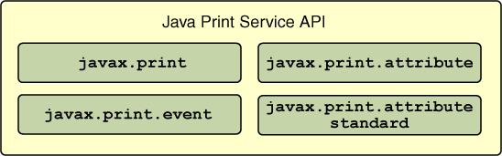
Working with Print Services and Attributes
The Java Print Service API consists of four packages:
The javax.print package provides the principal classes and interfaces for the Java Print Service API. It enables client and server applications to:
Discover and select print services based on their capabilities.
Specify the format of print data.
Submit print jobs to services that support the document type to be printed

Slide 14
Working with Print Services and Attributes
Document Type Specification
The DocFlavor class represents format of the print data, such as JPEG or PostScript.
The DocFlavor format consists of two parts:
a MIME type - describes the format
a representation class name - indicates how the document is delivered to the printer or output stream
This code sample demonstrates obtaining an array of StreamPrintServiceFactory objects that can return StreamPrintService objects able to convert a GIF image into PostScript:
DocFlavor flavor = DocFlavor.INPUT_STREAM.GIF;
String psMimeType = DocFlavor.BYTE_ARRAY. POSTSCRIPT.getMimeType(); StreamPrintServiceFactory[] psfactories = StreamPrintServiceFactory. ookupStreamPrintServiceFactories( flavor, psMimeType);

Slide 15
Working with Print Services and Attributes
Attribute Definitions
The javax.print.attribute and javax.print.attribute.standard packages define print attributes which describe the capabilities of a print service, specify the requirements of a print job, and track the progress of the print job.
PrintRequestAttributeSet attr_set = new HashPrintRequestAttributeSet();
attr_set.add(MediaSize.ISO_A4);
attr_set.add(new Copies(3));
You must pass the attribute set to the print job's print method, along with the DocFlavor

Slide 16
Working with Print Services and Attributes
Print Service Discovery
An application invokes the static methods of the abstract class PrintServiceLookup to locate print services that have the capabilities to satisfy the application's print request. For example, in order to print two copies of a double-sided document, the application first needs to find printers that have double-sided printing capability:
DocFlavor doc_flavor = DocFlavor.INPUT_STREAM.PDF;
PrintRequestAttributeSet attr_set = new HashPrintRequestAttributeSet();
attr_set.add(new Copies(2));
attr_set.add(Sides.DUPLEX);
PrintService[] service = PrintServiceLookup.lookupPrintServices(doc_flavor, attr_set);

Slide 17
Working with Print Services and Attributes
Common Use of the API
The Java Print Service API performs the following steps to process a print request:
Chooses a DocFlavor.
Creates a set of attributes.
Locates a print service that can handle the print request as specified by the DocFlavor and the attribute set.
Creates a Doc object encapsulating the DocFlavor and the actual print data.
Gets a print job, represented by DocPrintJob, from the print service.

Slide 18
Printing the Contents of a User Interface
Another common printing task is to print the contents of a window or a frame, either in whole, or in part. The window may contain the following components: toolbars, buttons sliders, text labels, scrollable text areas, images, and other graphical content. All of these components are printed using the following methods of the Java 2D printing API:
java.awt.Component.print(Graphics g);
java.awt.Component.printAll(Graphics g);

Slide 19
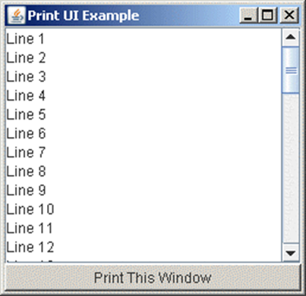
Printing the Contents of a User Interface
public int print(Graphics g, PageFormat pf, int page)
throws PrinterException {
if (page > 0) {
return NO_SUCH_PAGE;
}
Graphics2D g2d = (Graphics2D)g;
g2d.translate(pf.getImageableX(), pf.getImageableY());
// Print the entire visible contents of a
// java.awt.Frame.
frame.printAll(g);
return PAGE_EXISTS;
}
Note: The call to the printAll method is the only difference between this example and examples to print text or image.

